Slide 1
DEPLOYING A WEBSITE ON AWS S3 USING TERRAFORM AND JENKINS CI/CD PIPELINE
Pravin Sawant (230944223036)
Heena Shinganjude (230944223014)
Yogesh Dhanawade (230944223011)
Rutvija Patil (230344223034)

Slide 2
INTRODUCTION
In modern software development practices, deploying a website involves not only ensuring its functionality but also optimizing its performance, scalability, and security.Cloud computing services like Amazon Web Services (AWS) provide robust infrastructure solutions to address these requirements. Amazon S3 (Simple Storage Service) is a highly scalable and cost-effective object storage service offered by AWS.
Deploying a secure and automated static website hosting infrastructure on AWS S3 using Terraform and Jenkins CI/CD pipelines. Additionally, it integrates CloudFront for enhanced performance and security, Nagios for proactive monitoring, SonarQube for static code analysis, Trivy for container security scanning, and DynamoDB for scalable data storage. This comprehensive approach streamlines deployment processes, ensures code quality and security, and provides robust monitoring capabilities, ultimately enabling organizations to deliver high-quality websites efficiently and securely.

Slide 3
PROBLEM STATEMENT AND OBJECTIVES
Problem Statement:
Many organizations struggle with manual and error-prone deployment processes when hosting websites on cloud platforms like AWS S3. Additionally, ensuring security, code quality, and continuous monitoring poses significant challenges. Without automation and proper tooling, these tasks can become time-consuming and resource-intensive, leading to inefficiencies and potential risks to the website's reliability and security.
Objectives:
The primary objective of this project is to develop an automated pipeline for deploying websites on AWS S3 using Terraform and Jenkins CI/CD pipelines. Additionally, the project aims to integrate tools such as CloudFront, Nagios, SonarQube, Trivy, and DynamoDB to address the following objectives:
Automate Deployment: Streamline the deployment process to reduce manual effort and errors, ensuring consistent and reliable deployments of websites on AWS S3.
Enhance Security: Integrate CloudFront for DDoS protection, HTTPS encryption, and access control to enhance the security of the deployed websites, ensuring data integrity and confidentiality.
Ensure Code Quality: Utilize SonarQube for static code analysis to identify and address code quality issues, ensuring the reliability and maintainability of the deployed websites.
Ensure Container Security: Integrate Trivy for container security scanning to identify and remediate vulnerabilities in containerized components, ensuring the security of the deployment environment.
Enable Proactive Monitoring: Integrate Nagios for proactive monitoring of AWS resources, including S3 buckets, CloudFront distributions, and other critical components, enabling timely detection and resolution of issues.
Provide Scalable Data Storage: Utilize DynamoDB for scalable and low-latency data storage, enabling dynamic website components to access and store data efficiently

Slide 4
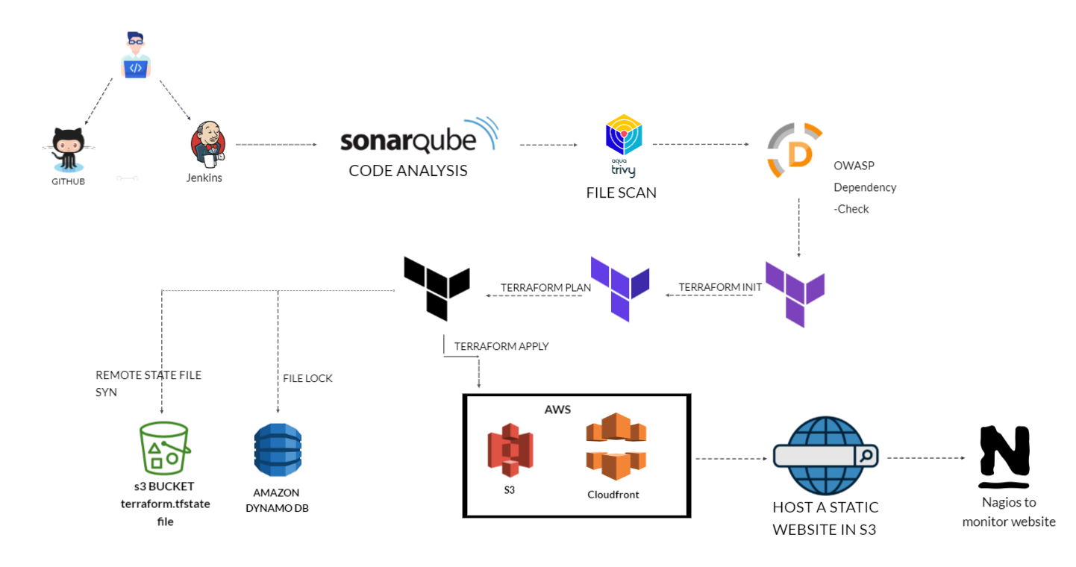
PROPOSED SYSTEM ARCHITECTURE

Slide 5
TECHNOLOGIES/SERVICES USED
1.Terraform : Terraform is an open-source infrastructure as code software tool that enables users to define and provision infrastructure resources using declarative configuration files.
2.Git : Git is a distributed version control system used for tracking changes in source code during software development.
3.Jenkins : Jenkins is an open-source automation server used for Continuous Integration and Continuous Delivery (CI/CD) of software projects.
4.Sonarqube : SonarQube is an open-source platform for continuous inspection of code quality and security vulnerabilities in software projects.
5.Trivy : Trivy is an open-source vulnerability scanner for container images, providing fast and comprehensive security analysis.

Slide 6
6.Amazon S3: Amazon S3 bucket is a scalable object storage service provided by Amazon Web Services (AWS) for storing and retrieving data.
7.Amazon dynamoDB : DynamoDB is a fully managed NoSQL database service offered by Amazon Web Services (AWS) for high-performance and scalable data storage.
8.Nagios : Nagios is an open-source monitoring solution used for continuous monitoring of IT infrastructure to detect and resolve issues proactively.

Slide 7
METHODOLOGY
1.Requirement Analysis:
Define project objectives, scope, and requirements, including the features and components of the website to be deployed on AWS S3.
Identify the AWS resources needed for hosting the website, such as S3 buckets, CloudFront distributions, and DynamoDB tables.
2.Environment Setup:
Set up version control using Git for managing the website's codebase.
Configure development, testing, and production environments for deployment.
Provision AWS credentials with appropriate permissions for Terraform, Jenkins, and other tools.

Slide 8
3.Infrastructure Provisioning with Terraform:
Develop Terraform scripts to define the infrastructure components required for hosting the website on AWS S3.
Define AWS resources such as S3 buckets, CloudFront distributions, Route 53 DNS records, and DynamoDB tables using Terraform configuration files.
4.Continuous Integration and Deployment with Jenkins:
Configure Jenkins CI/CD pipelines to automate the build, test, and deployment processes.
Integrate Jenkins with Git to trigger pipeline executions upon code commits or merges.
Implement stages in the pipeline for compiling code, running tests, and deploying artifacts to AWS S3.
5.Security Integration with CloudFront:
Configure CloudFront distributions with security features such as DDoS protection, HTTPS encryption, and access control.
Ensure proper configuration of CloudFront cache behaviors and origin settings for optimal performance and security.

Slide 9
6.Code Quality Analysis with SonarQube:
Set up SonarQube for static code analysis to identify and address code quality issues in the website's codebase.
Configure SonarQube analysis tasks in the Jenkins pipeline to analyze code quality metrics during the build process.
7.Container Security Scanning with Trivy:
Integrate Trivy into the Jenkins pipeline to scan container images for vulnerabilities before deployment.
Define Trivy scanning tasks to analyze container images for known security vulnerabilities and dependencies.
8.Proactive Monitoring with Nagios:
Deploy Nagios for proactive monitoring of AWS resources, including S3 buckets, CloudFront distributions, and DynamoDB tables.
Configure Nagios checks and alerts to monitor critical metrics such as website availability, latency, and resource utilization.

Slide 10
9.Testing and Validation:
Conduct thorough testing of the deployment pipeline to ensure functionality, reliability, and performance.
Validate website deployment on AWS S3 and verify proper functioning of security configurations, code quality analysis, and monitoring systems.
10.Documentation and Knowledge Sharing:
Document the project setup, configurations, and workflows for future reference and knowledge sharing.
Provide training and guidance to team members on using and maintaining the deployed infrastructure and CI/CD pipeline.

Slide 11
CONCLUSION
Hence, we have successfully implemented an automated pipeline for deploying websites on AWS S3 using Terraform and Jenkins CI/CD pipelines, with additional tools like CloudFront, Nagios, SonarQube, Trivy, and DynamoDB. The streamlined process improved efficiency, enhanced security, ensured code quality, enabled proactive monitoring, and provided scalable data storage. Overall, these outcomes contribute to more reliable and secure website deployments, ultimately enhancing the user experience.

Slide 12
REFERENCES
Paper 1: - A Qualitative Study of DevOps Usage in Practice
Author: Floris Erich, C. Amrit & M. Daneva
Paper 2: - Review paper on Network's server monitoring and analysis using Nagios
Author: Renita Johnson, N. Edna Elizabeth
Paper 3: - DevOps: Introducing Infrastructure-as-Code
Author: Matej Arta, Tadej Borovˇsak, Elisabetta Di Nitto, Michele Guerriero
Paper 4: - DevOps: Introducing Infrastructure-as-Code
Author:Md Rejaul Karim Chowdhury and Abdullah Gani

